Slide 1
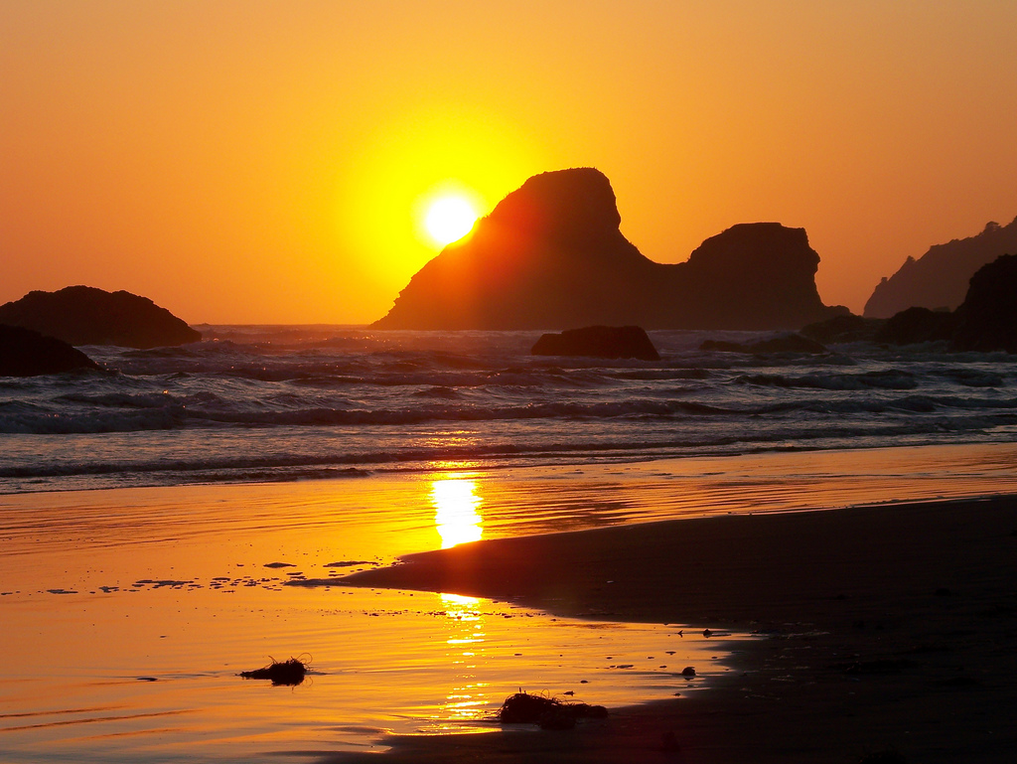
Wonder Full World

Slide 2
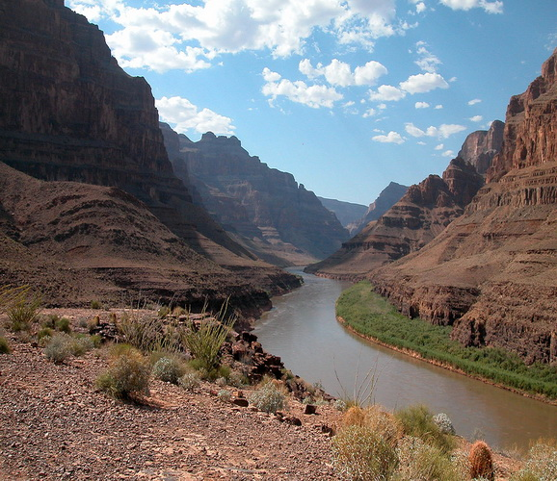
Grand Canyon

Slide 3
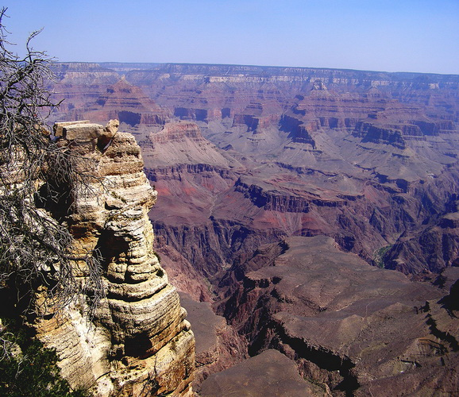
Grand Canyon

Slide 4
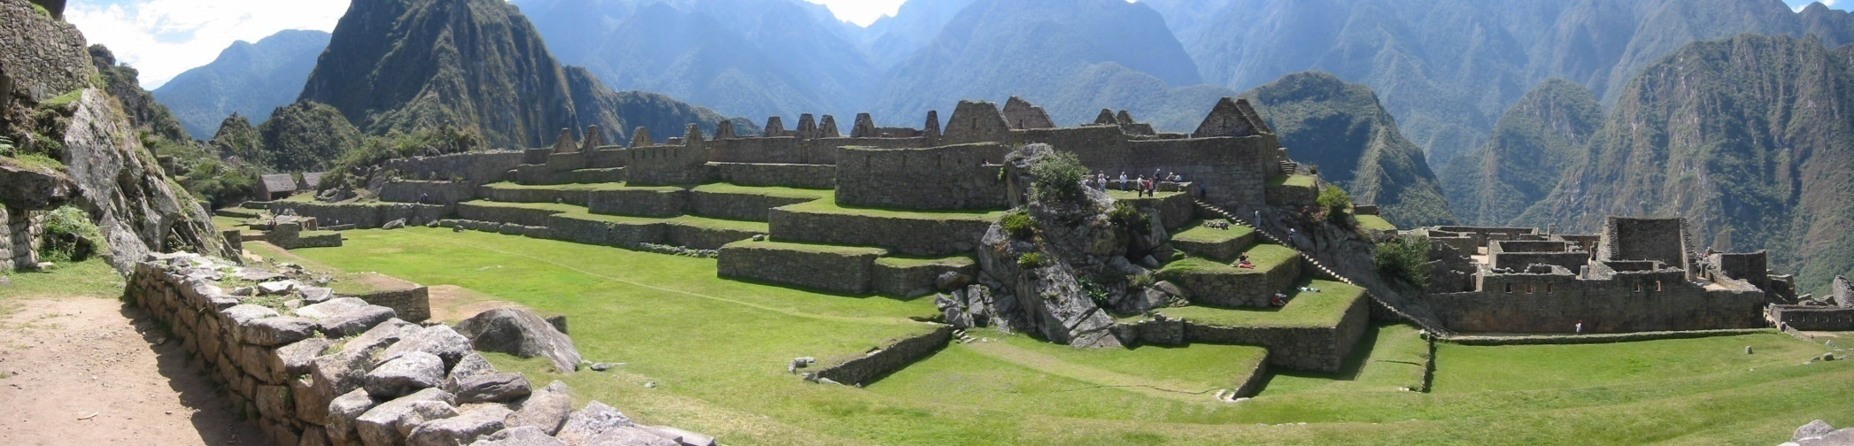
Machu Picchu, Peru

Slide 5
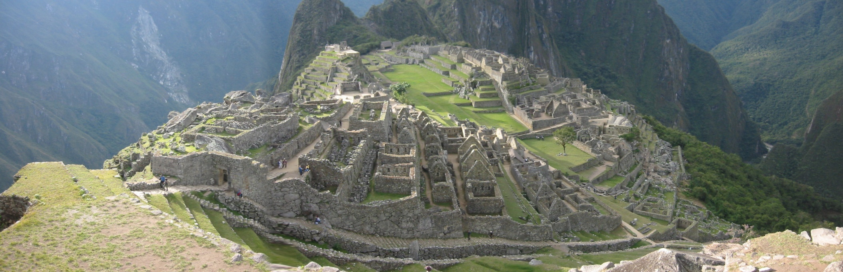
Machu Picchu, Peru

Slide 6
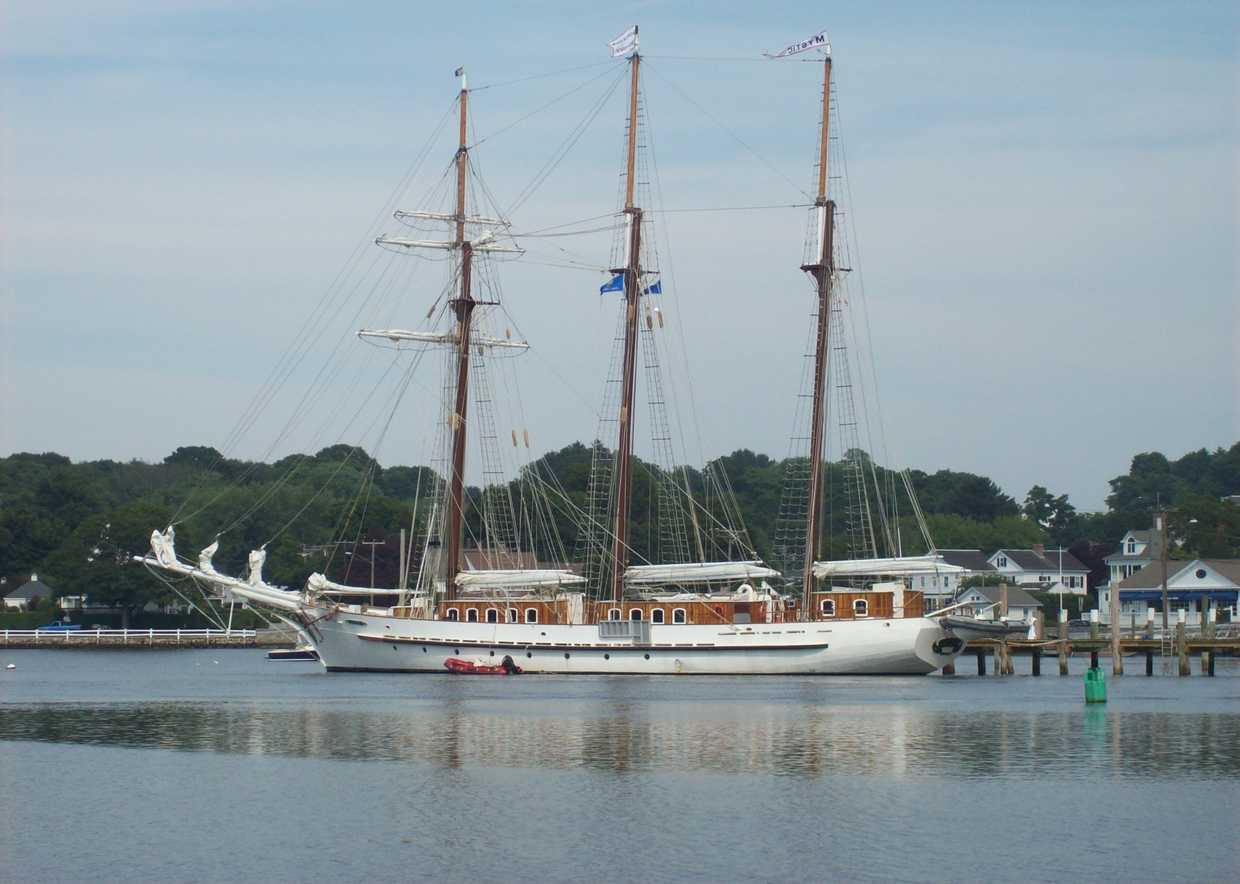
Mystic Ship, Mystic, CT

Slide 7
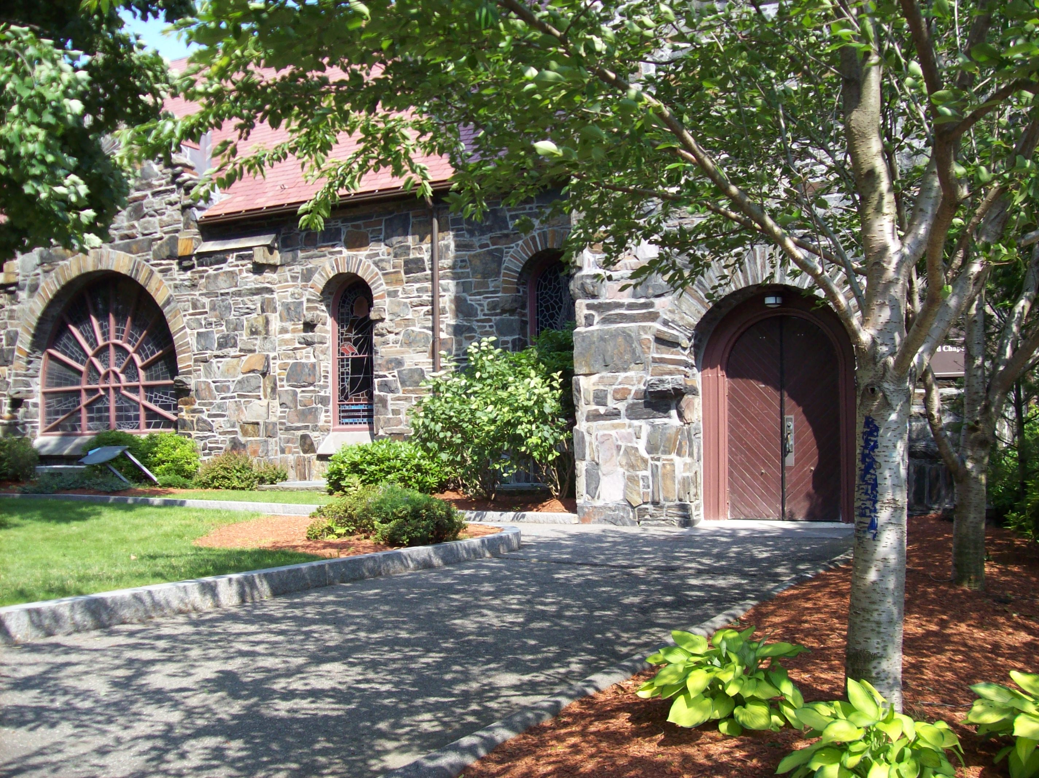
Tufts University, Boston, MA

Slide 8
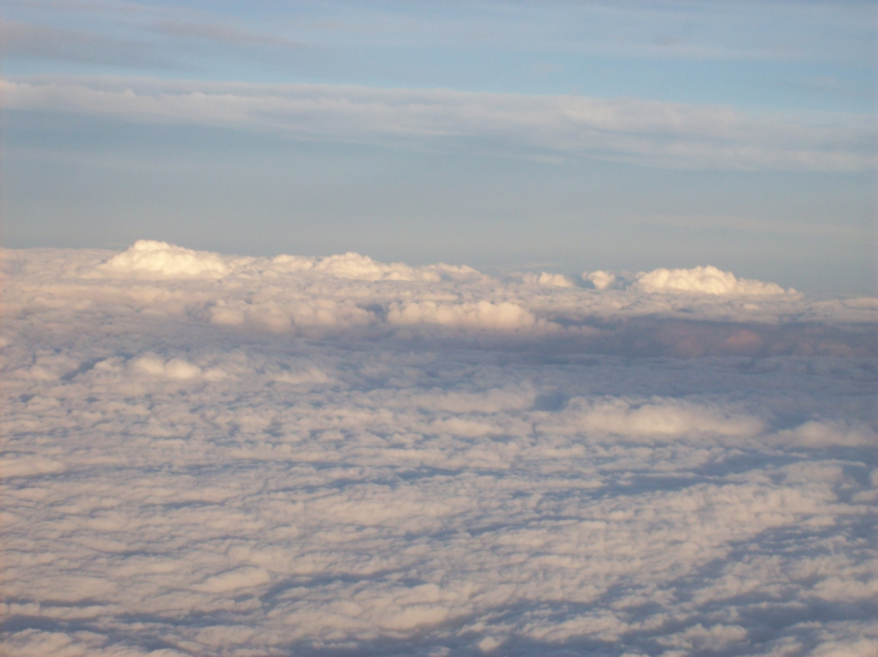
Sea of Clouds
Beauty from above

Slide 9
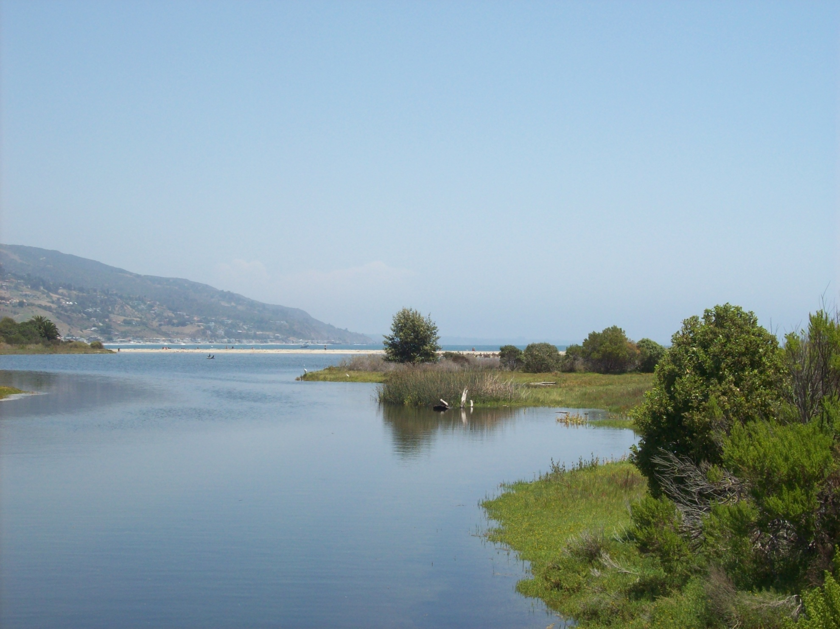
Malibu, California

Slide 10
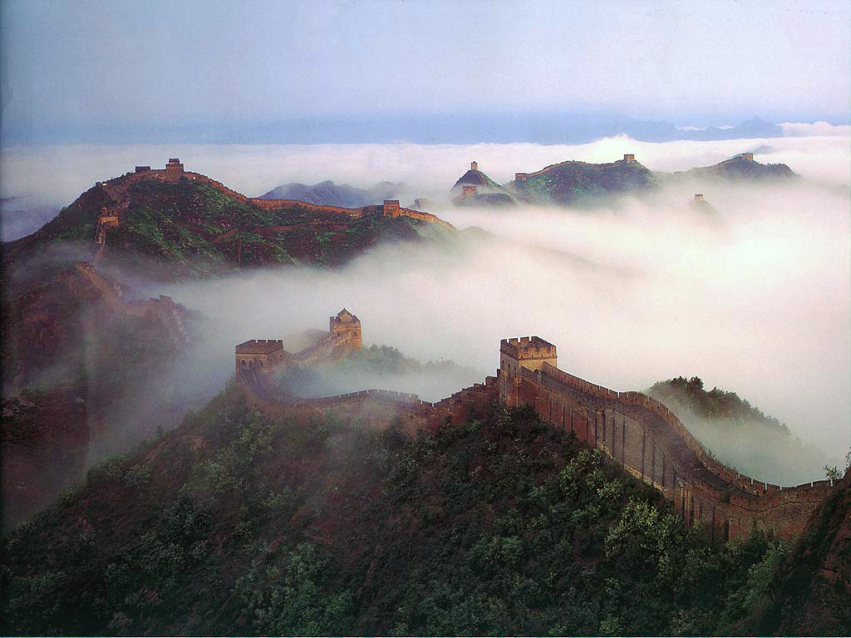
Great Wall of China
Without crane or bulldozer…

Slide 11
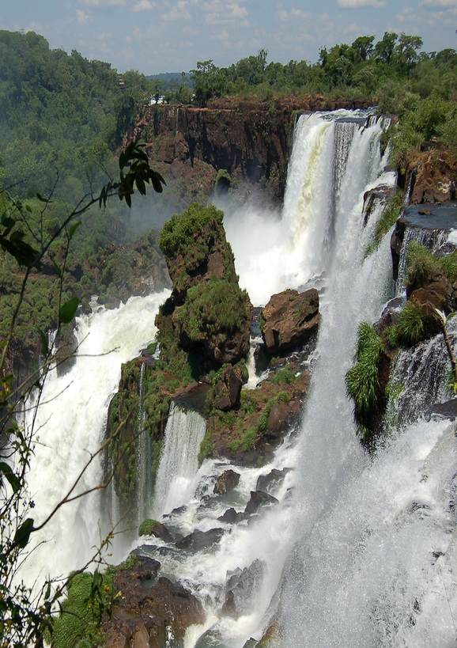
Iguazu Waterfalls, Argentina

Slide 12
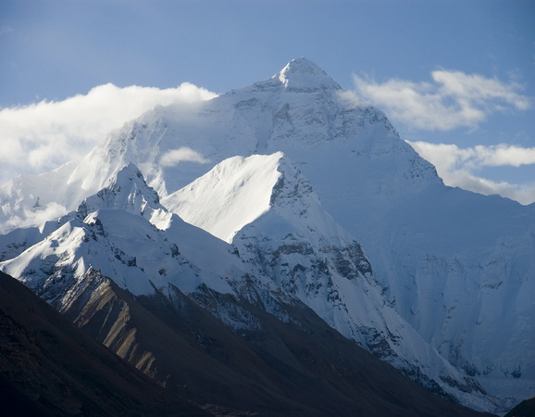
Mt. Everest, Nepal

Slide 13
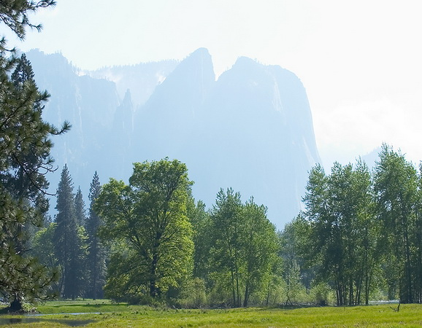
Yosemite, California

Slide 14
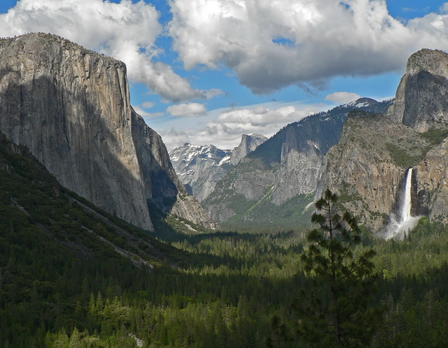
Yosemite, California

Slide 15
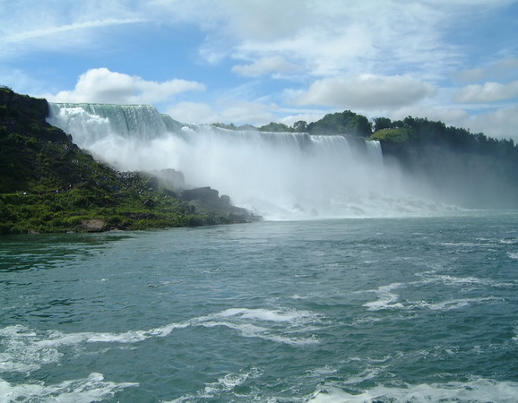
Niagara Falls, New York

Slide 16
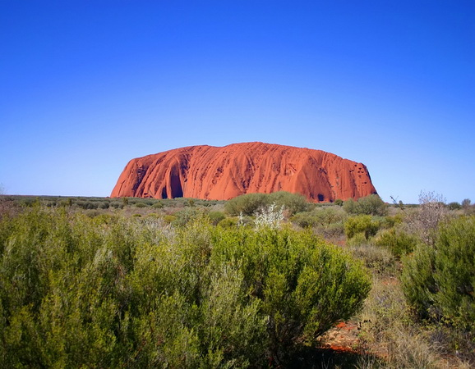
Ayers Rock, Australia

Slide 17
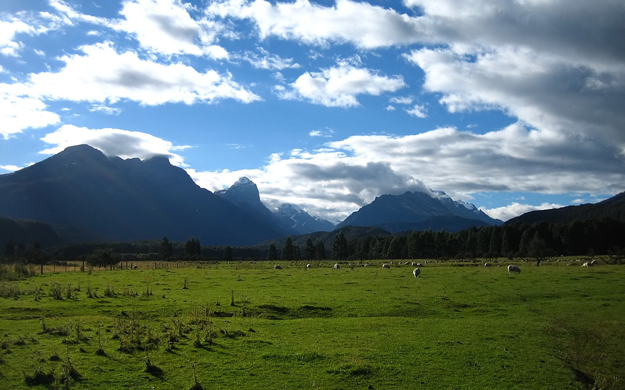
Dart River Valley, Paradise, NZ

Slide 18
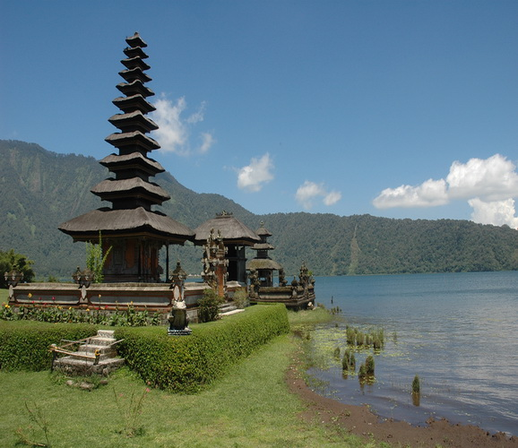
Bali

Slide 19
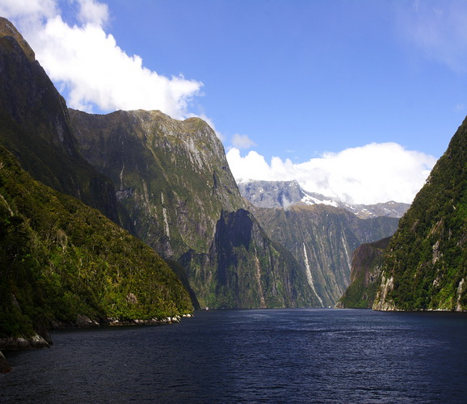
Milford Sound, NZ

Slide 20
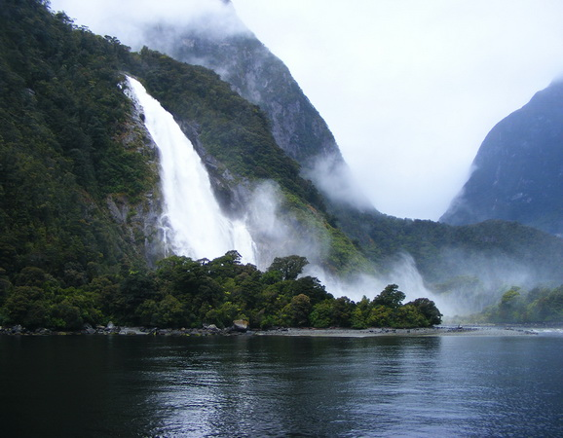
Milford Sound, NZ

Slide 21
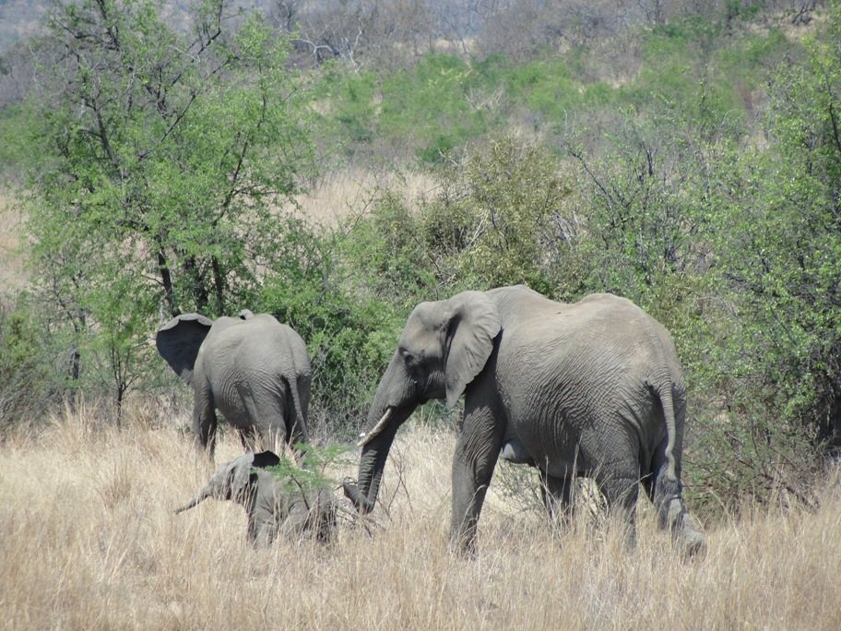
South Africa

Slide 22
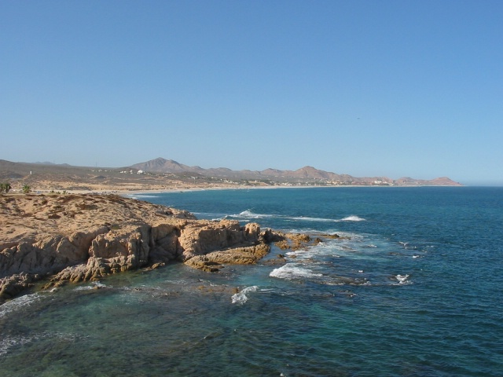
Cabo San Lucas, Mexico

Slide 23
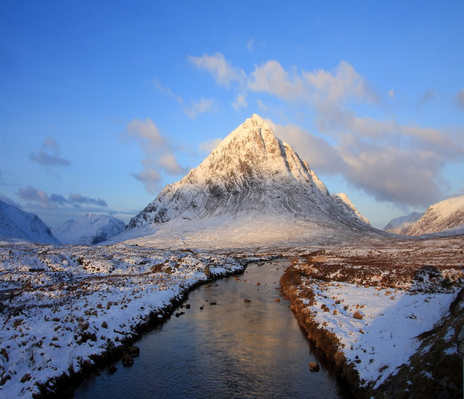
Glencoe, Scotland

Slide 24
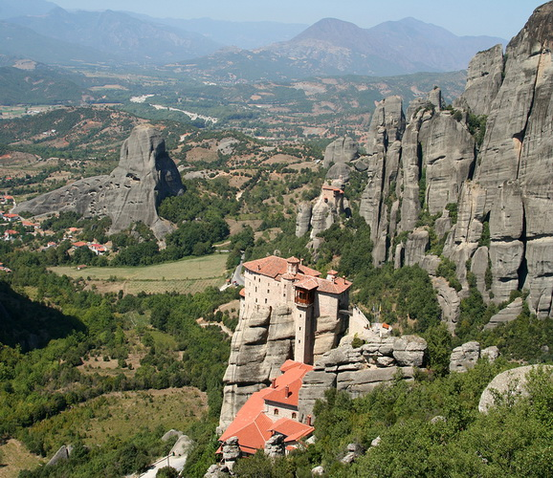
Meteors Monasteries, Greece
Who looked at these rocks and thought
“Let’s put a building up there?”

Slide 25
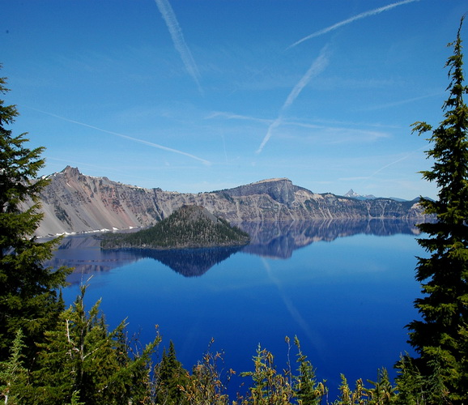
Crater Lake, Oregon

Slide 26
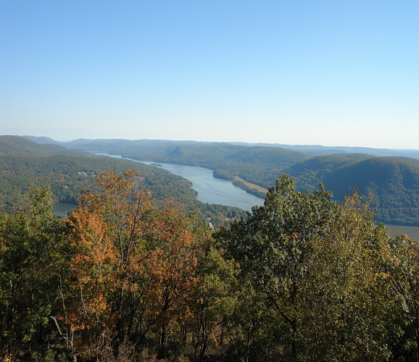
Hudson River Valley, New York

Slide 27
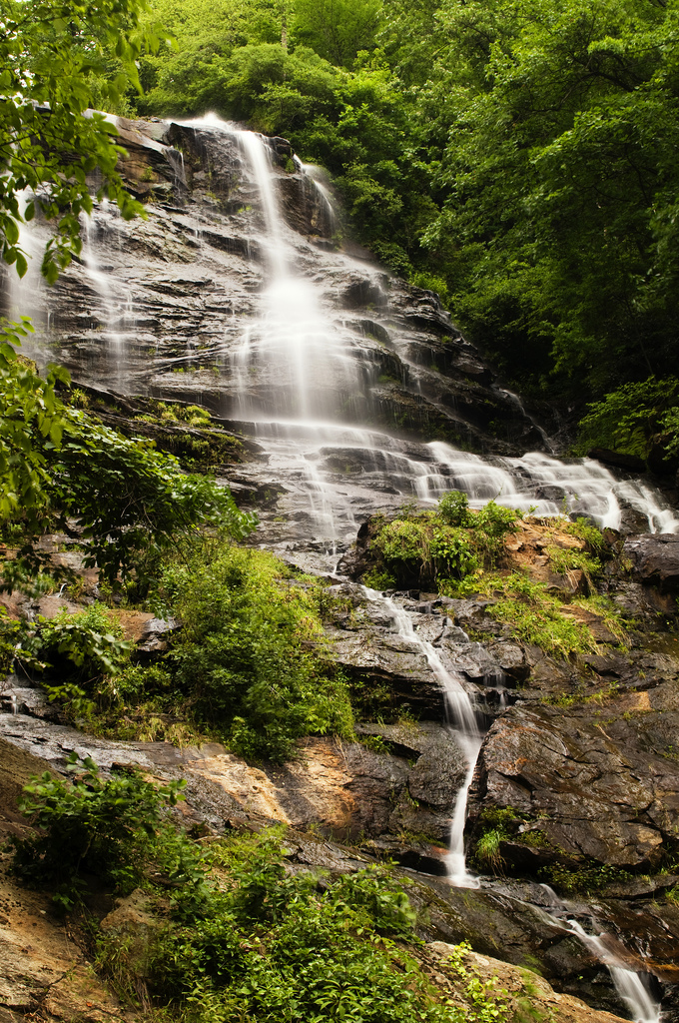
Amicalola Falls, Georgia

Slide 28
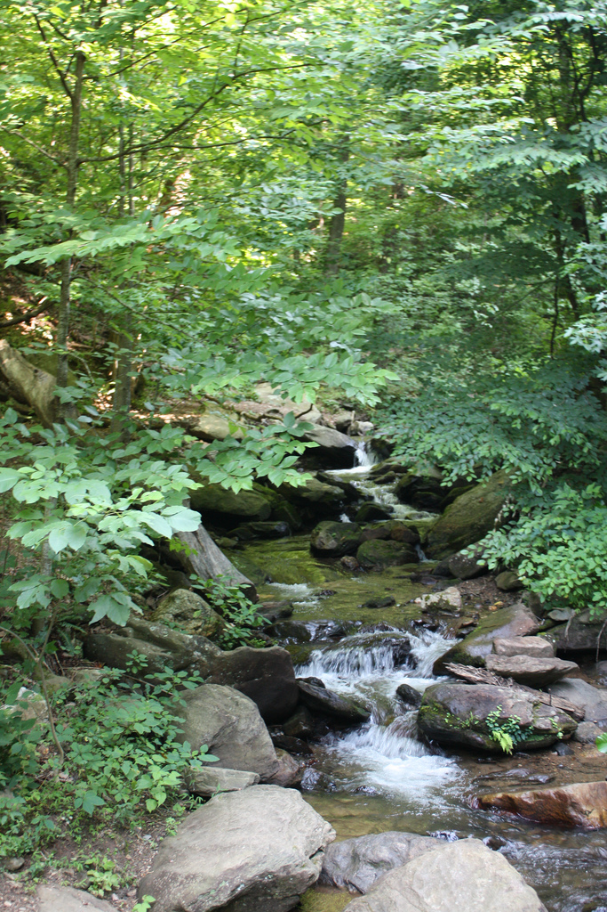
Amicalola Falls, Georgia

Slide 29
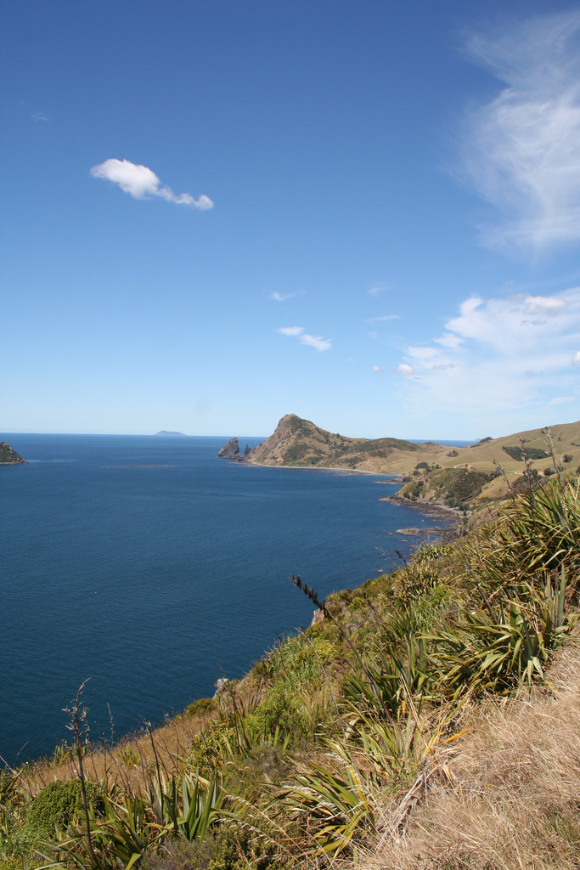
Coromandel Peninsula, NZ

Slide 30
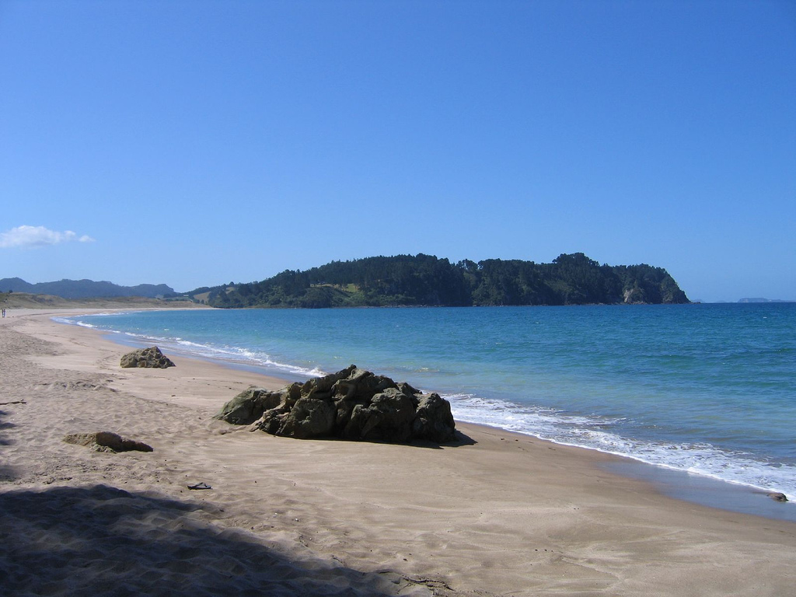
Coromandel Peninsula, NZ

Slide 31
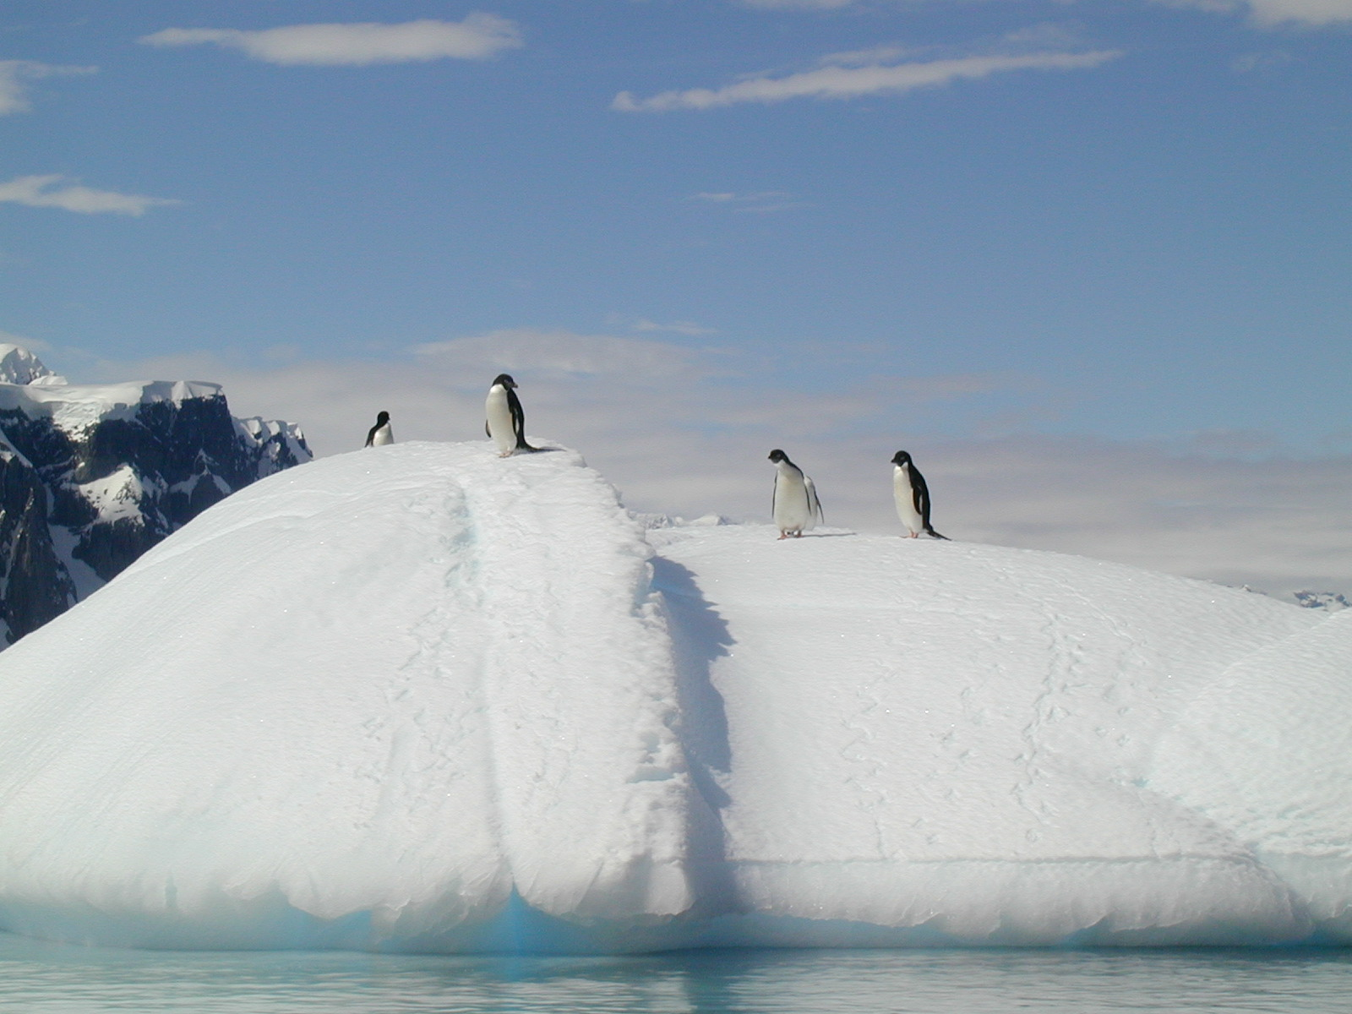
Antarctica

Slide 32
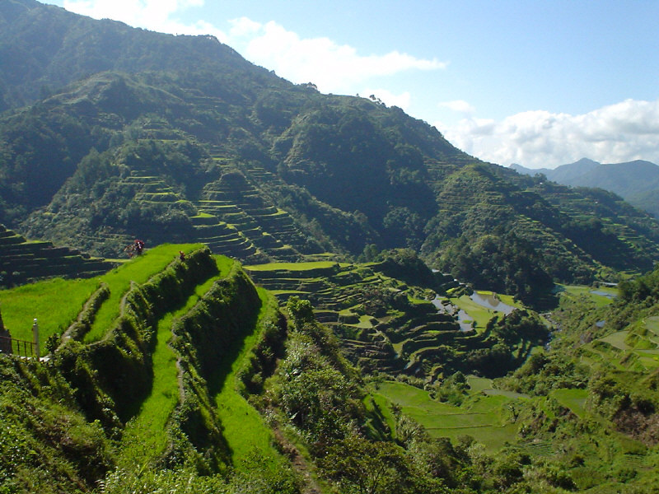
Banaue Rice Terraces, Philippines

Slide 33
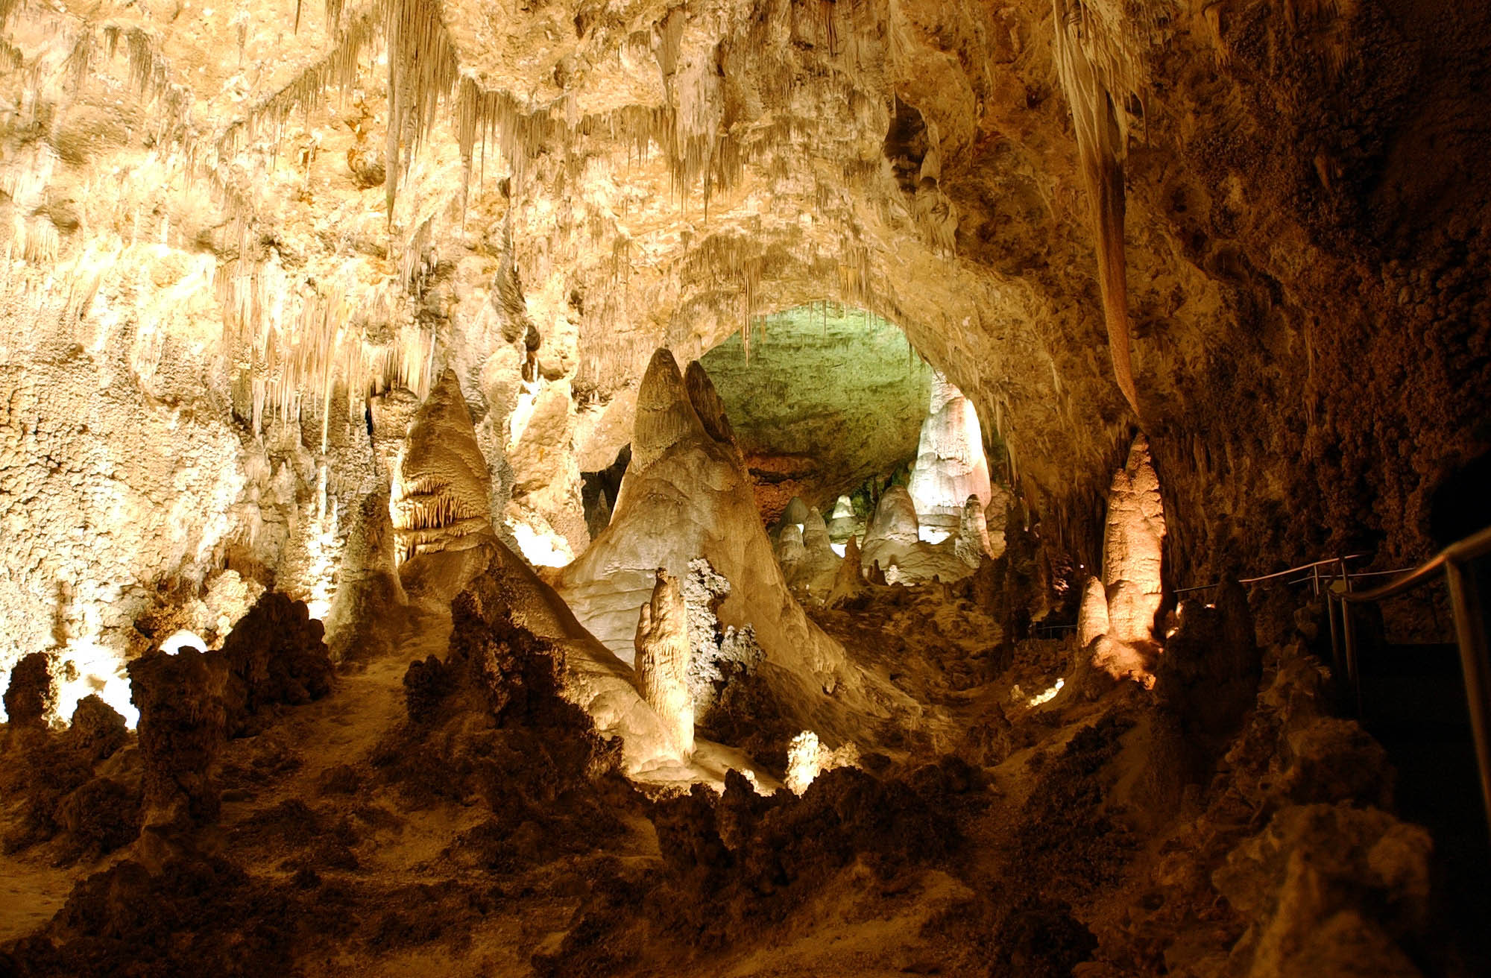
Carlsbad Caverns, New Mexico

Slide 34
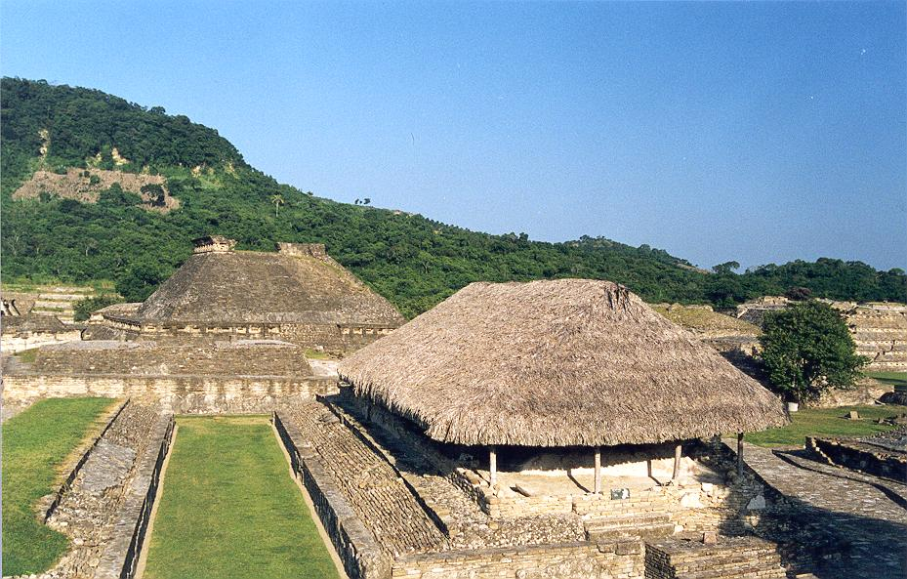
El Tajin, Mexico

Slide 35
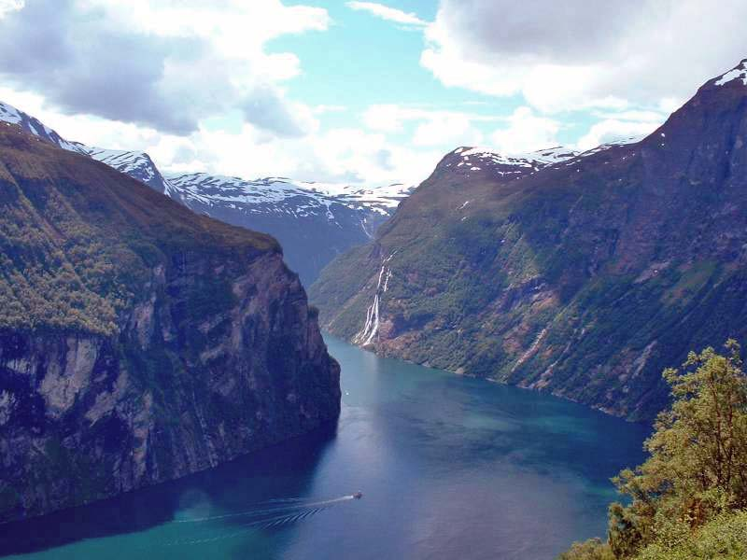
Fjord Geiranger, Norway

Slide 36
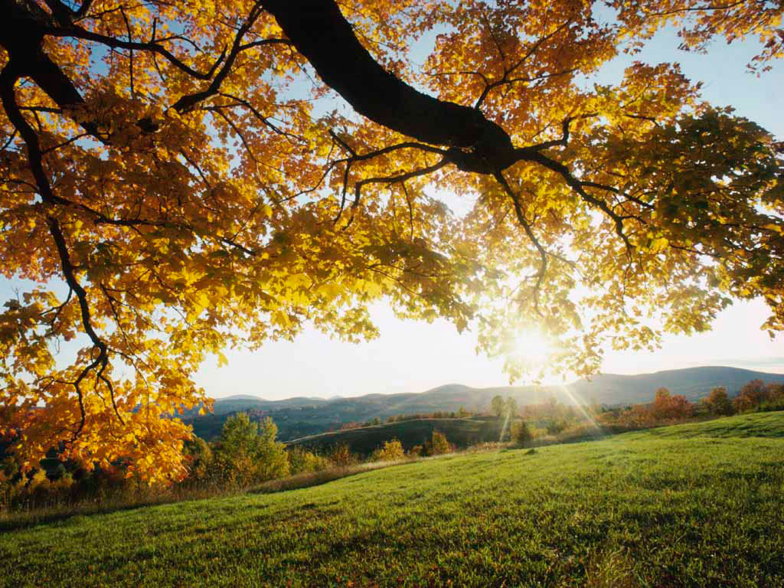
Autumn Leaves

Slide 37
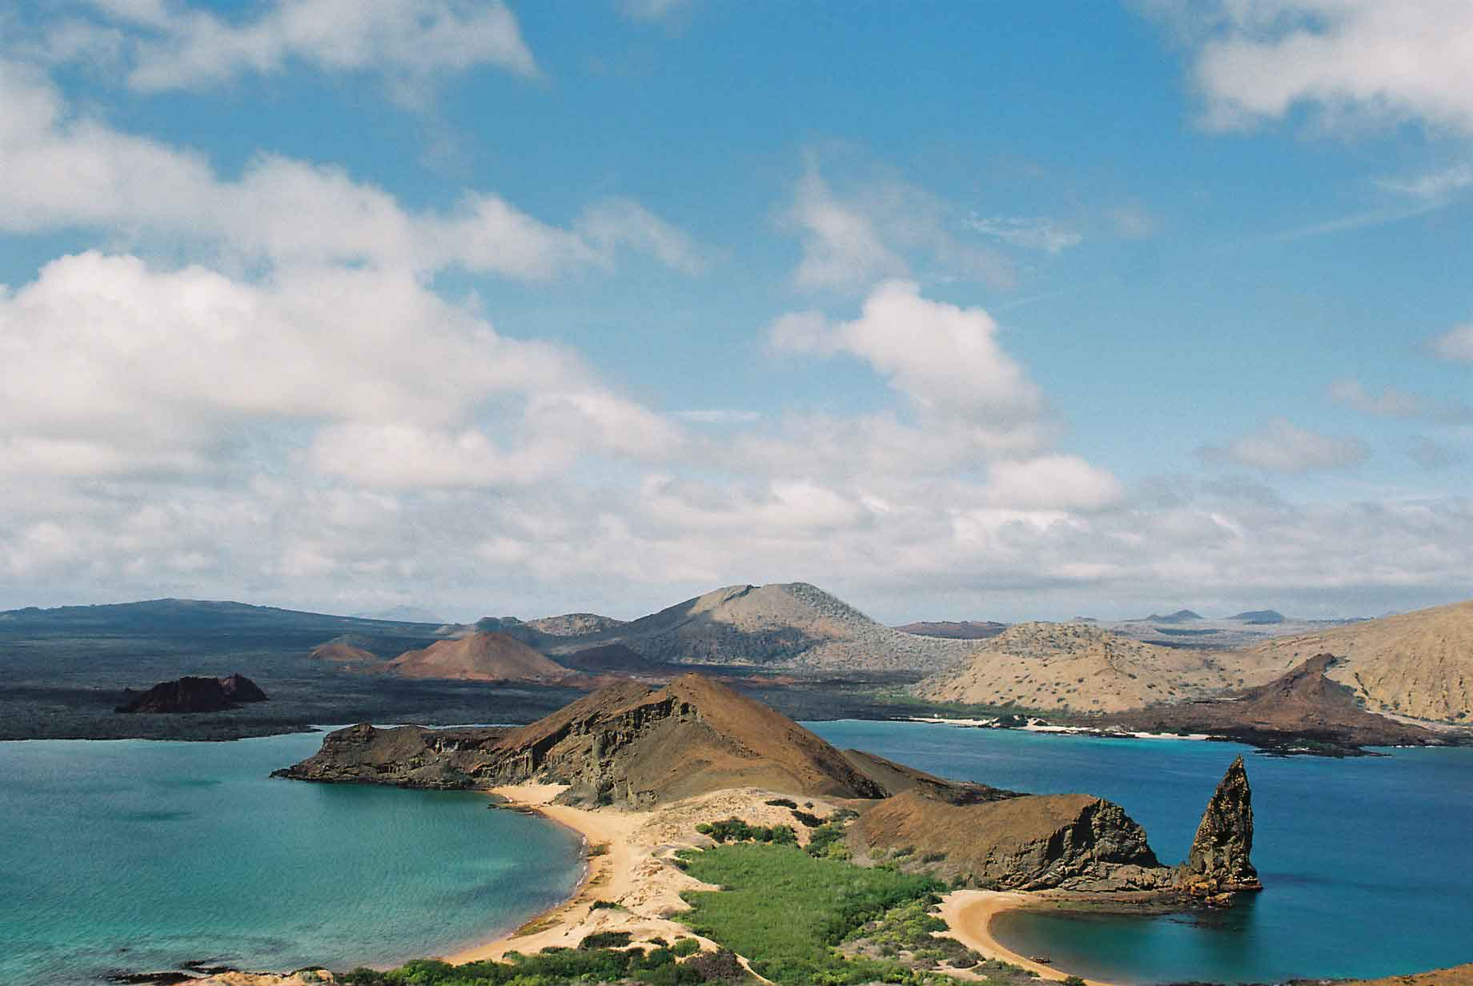
Galapagos, Ecuador

Slide 38
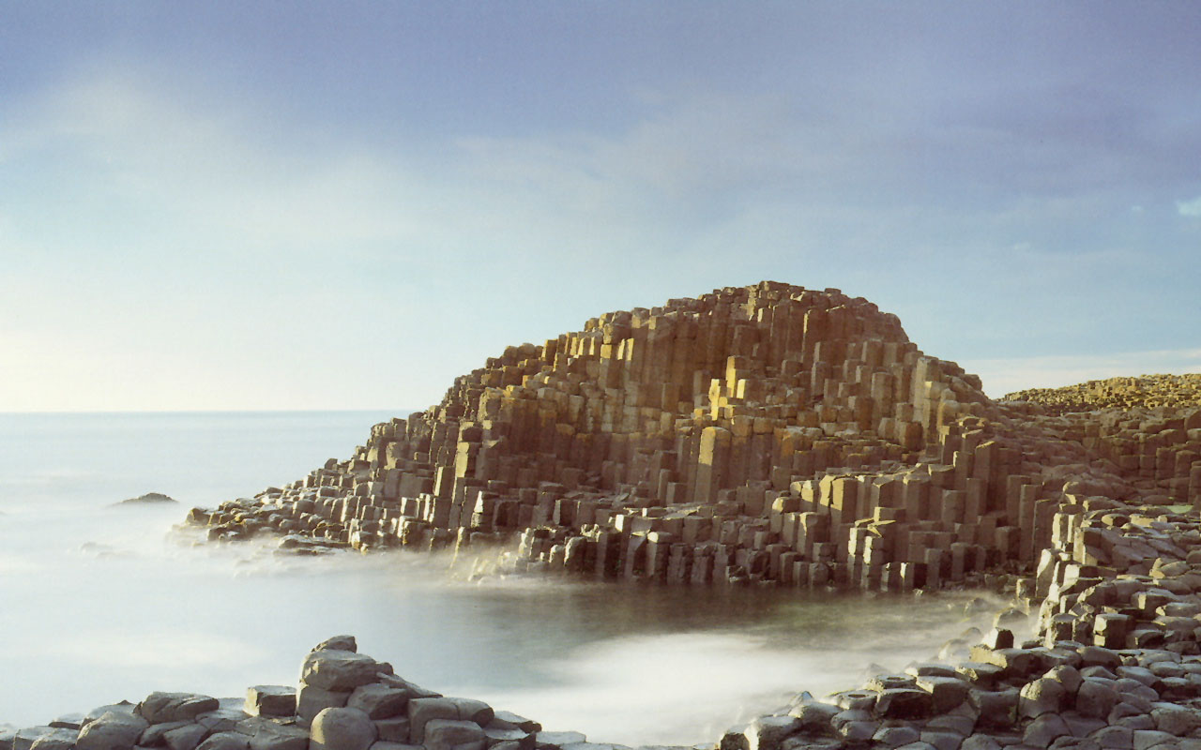
Giants’ Causeway, Northern Ireland

Slide 39
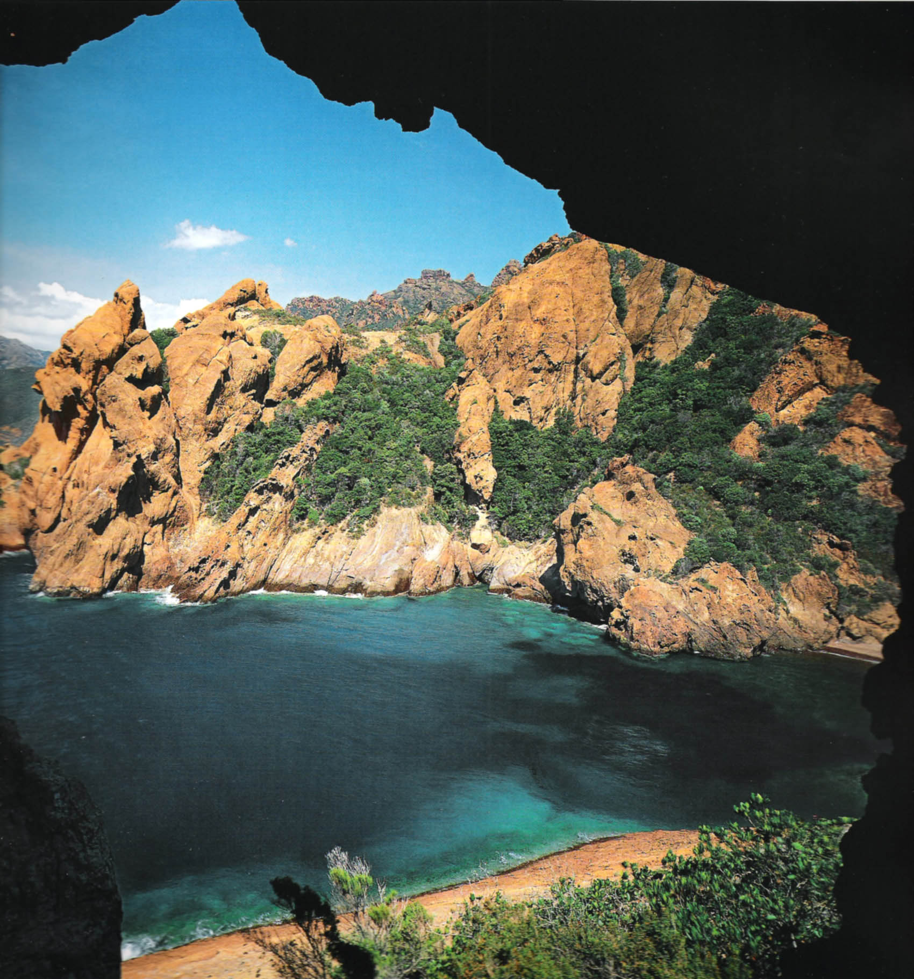
Girolata, Corisca

Slide 40
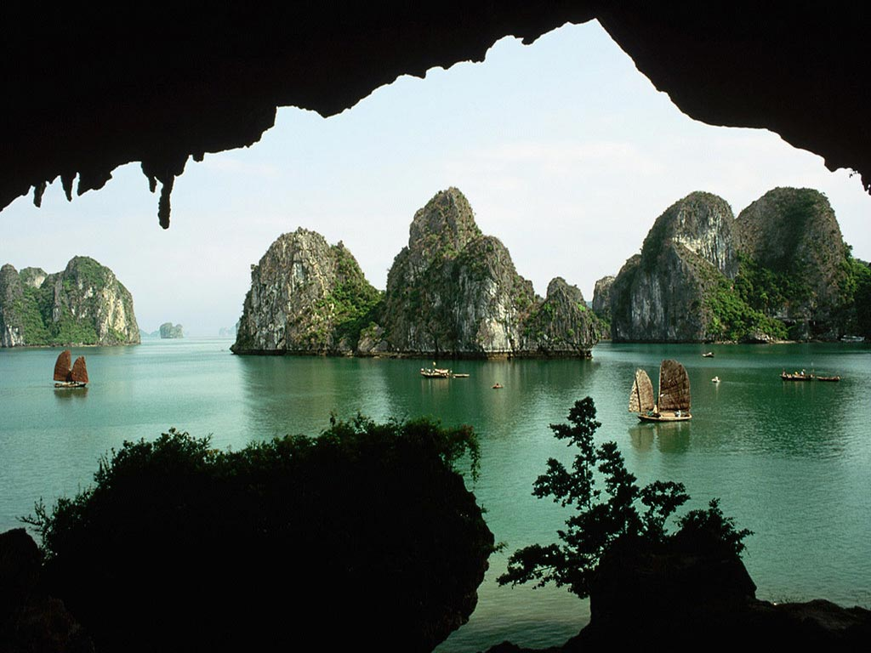
Halong Bay, Vietnam

Slide 41
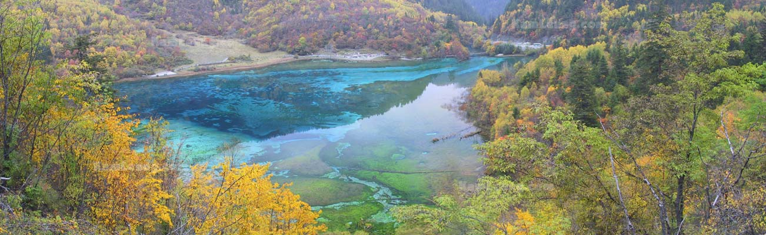
Jiuzhaigou River, China

Slide 42
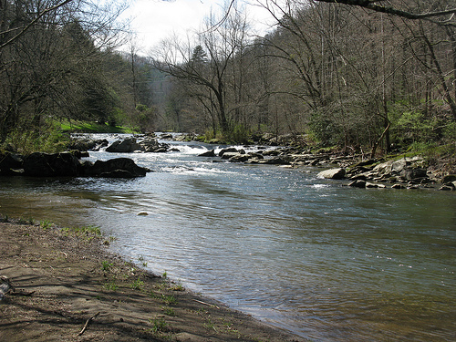
Little Pigeon River, Smoky Mountains

Slide 43
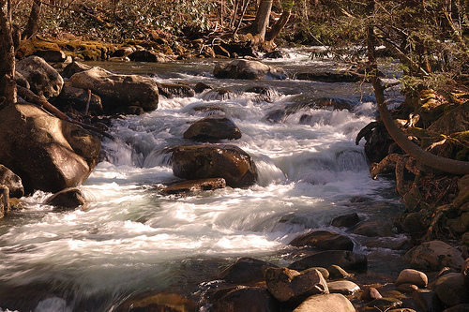
Little Pigeon River, Smoky Mountains

Slide 44
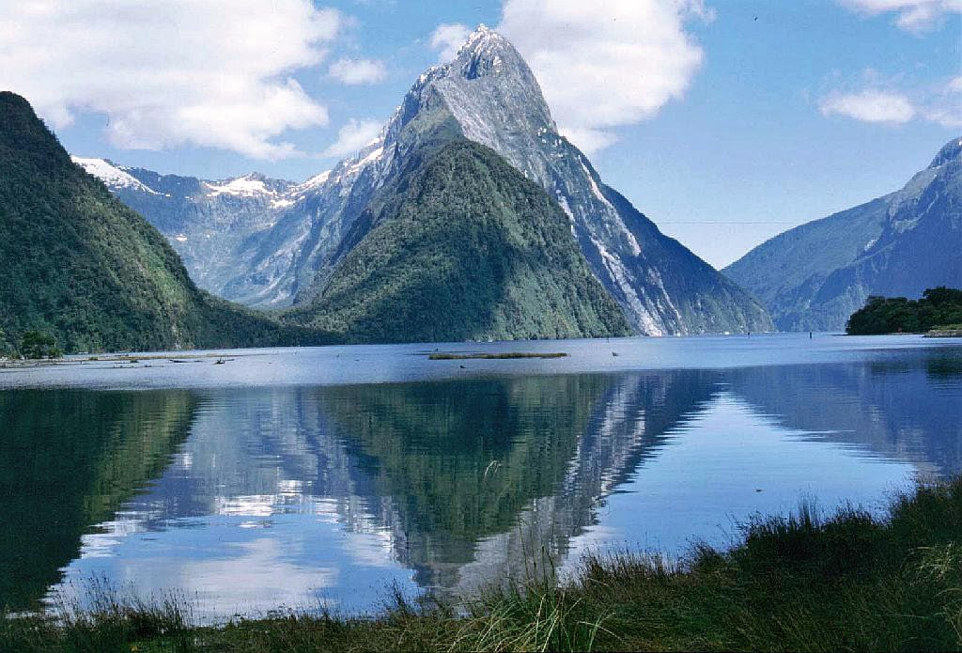
Mitre Peak, NZ

Slide 45
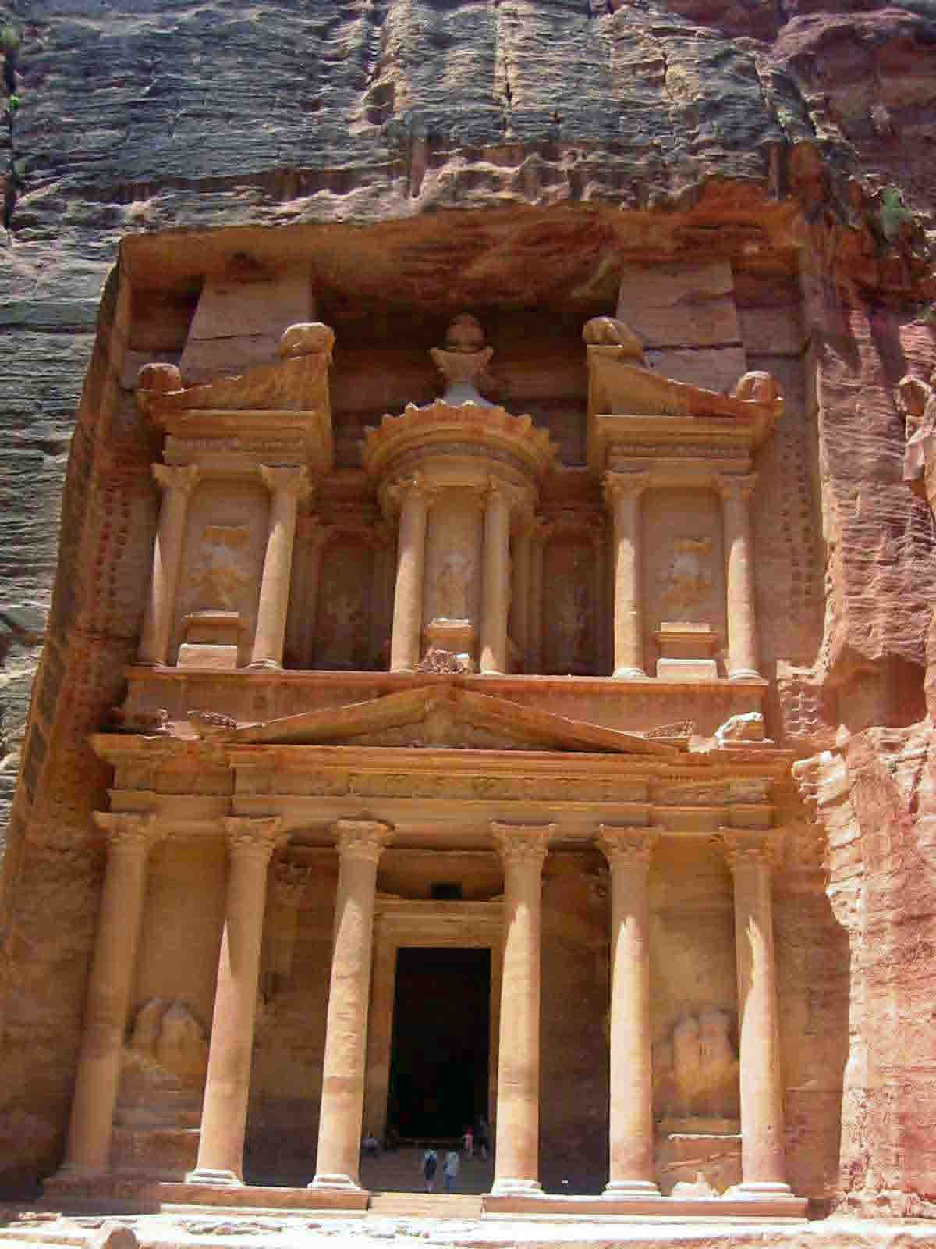
Petra, Jordan

Slide 46
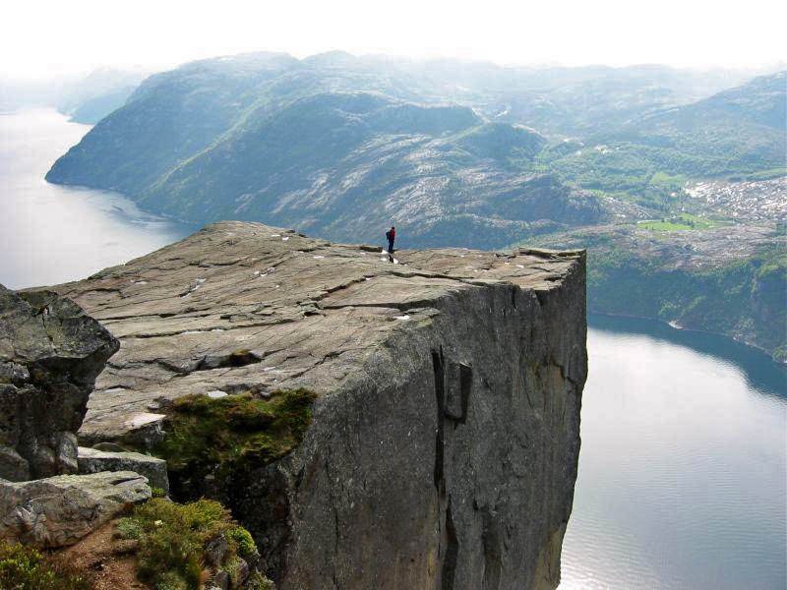
Preikestole Fjord, Norway

Slide 47
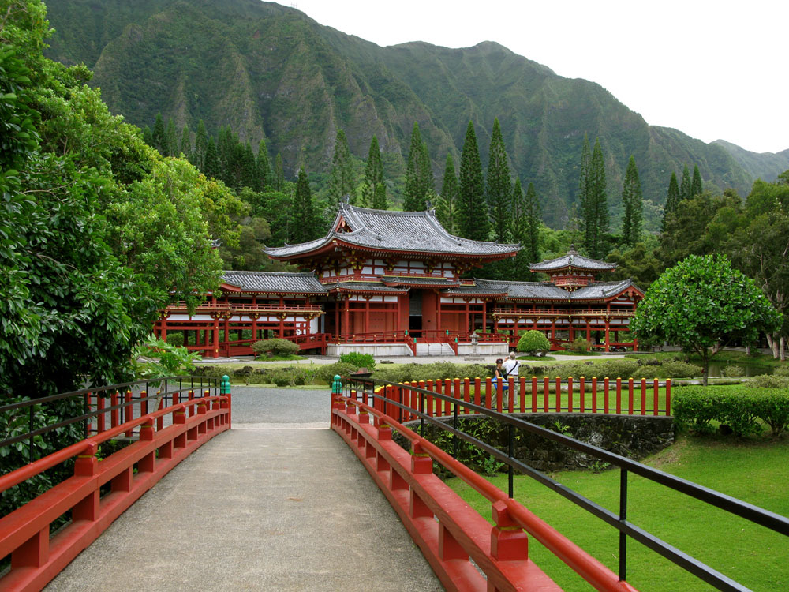
Valley of the Temples, Hawaii

Slide 48
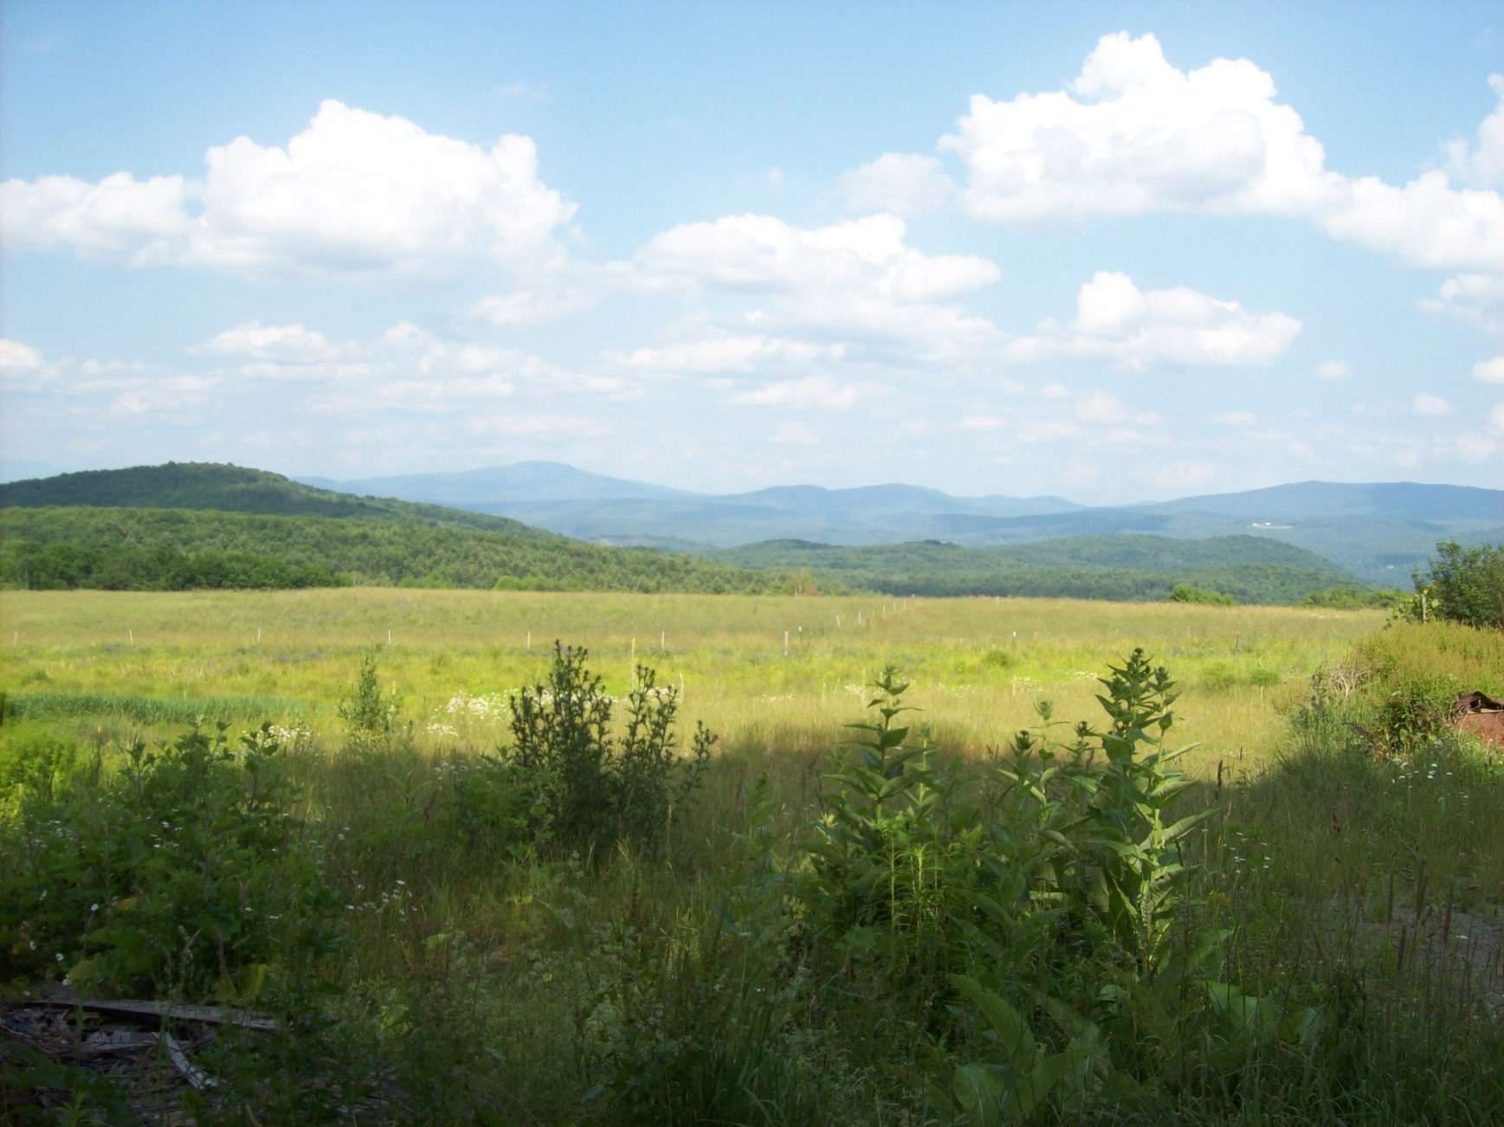
Vermont

Slide 49
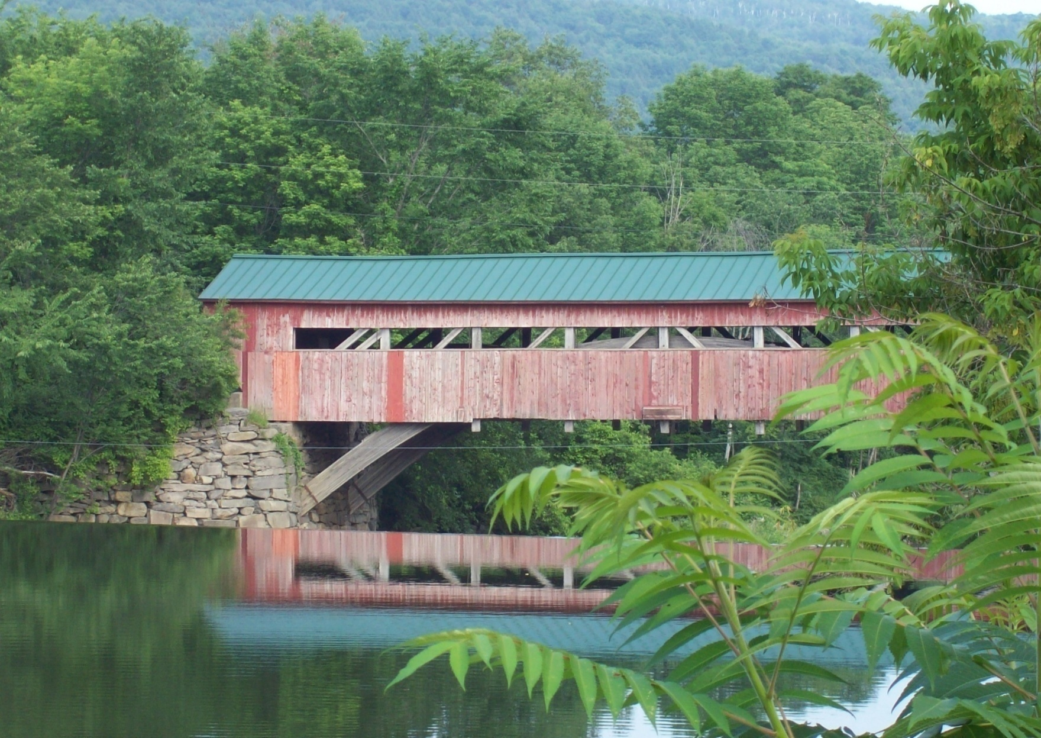
New England

Slide 50
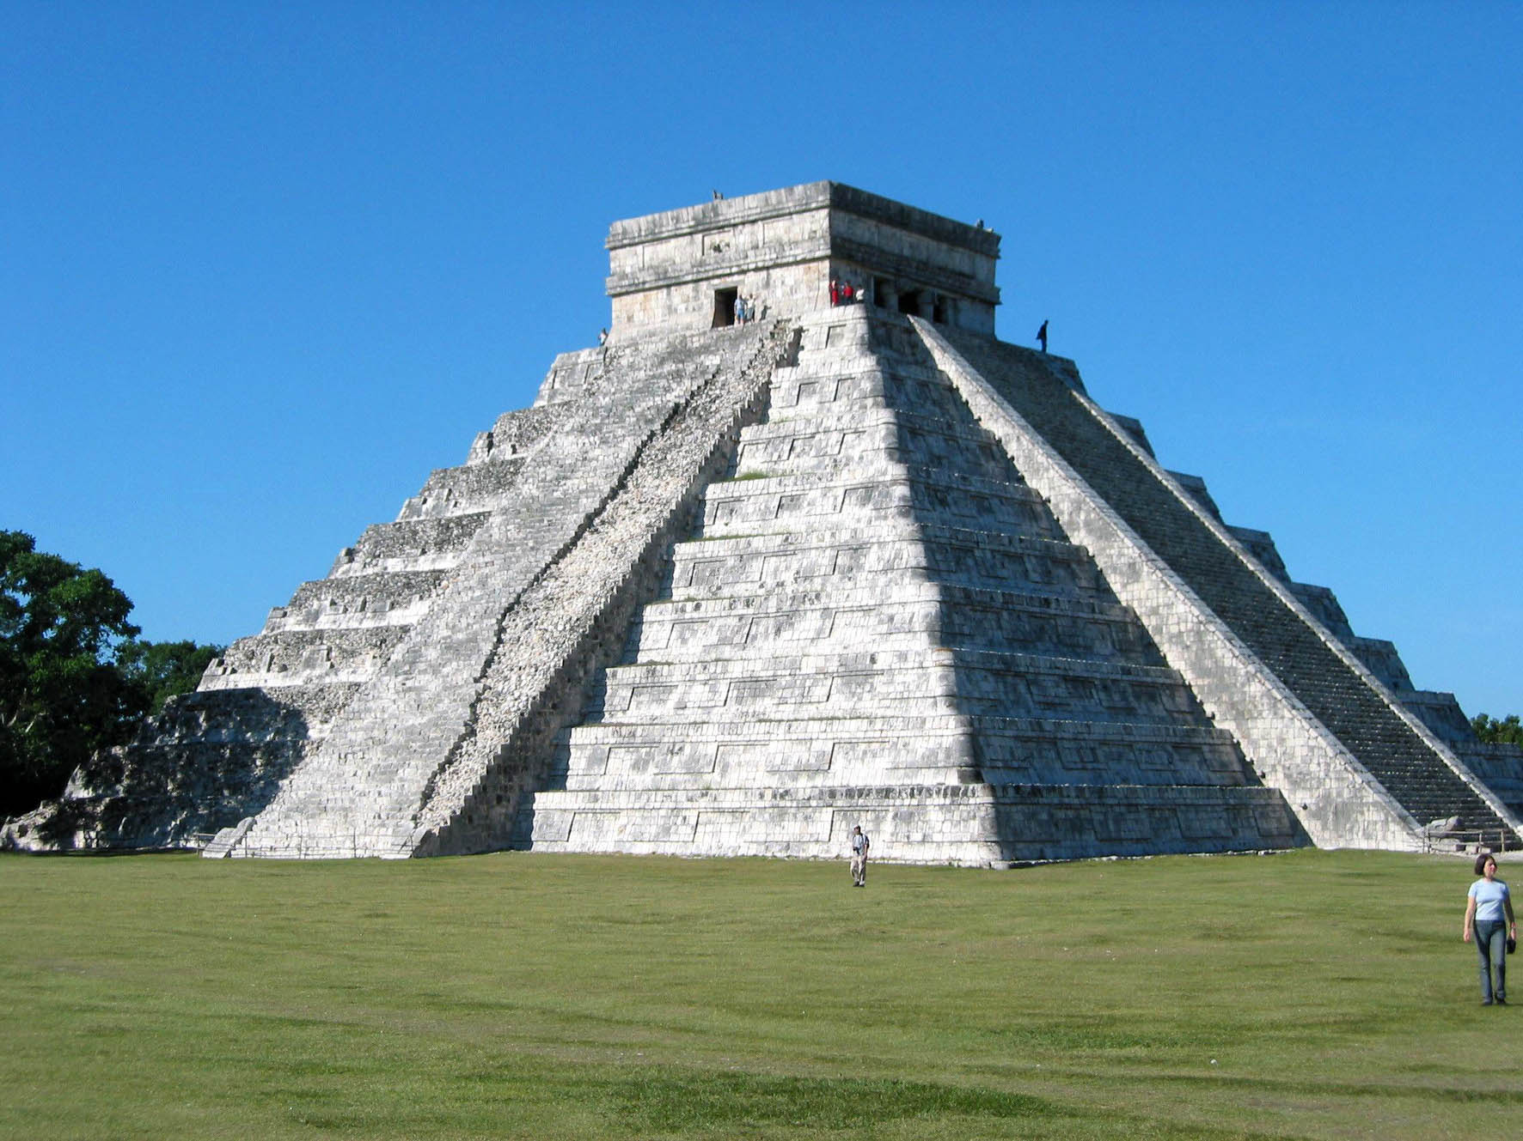
Chichen Itza, Mexico

Slide 51

Sistine Chapel

Slide 52

Cordoba Mosque, Spain

Slide 53

Alaska

Slide 54

Glacier Bay, Alaska

Slide 55

Haast Valley, NZ

Slide 56

Smoky Mountains

Slide 57

Warner Park, Nashville, TN

Slide 58

Smoky Mountains

Slide 59

Pitts Theological Library, Emory University

Slide 60

Snake River (Pacific Northwest)

Slide 61

Snake River Ansel Adams

Slide 62

Cups of Snow, Georgia

Slide 63

The Road Taken

Slide 64

Home

